Slide 1

CAPSTONE PROJECT
E-COMMERCE SALES PERFORMANCE ANALYSIS USING POWER BI
Presented By
Student Name: PURUSHOTTAM RAJ
College Name: NETAJI SUBHAS UNIVERSITY
Department: MCA (IT)

Slide 2
OUTLINE:
Problem Statement
Proposed System/Solution
System Development Approach (Technology Used)
Algorithm & Deployment
Result (Output Image)
Conclusion
Future Scope
References

Slide 3
Problem Statement:
E-commerce platforms generate large volumes of transactional data from sales, customers, and payment methods. However, many businesses struggle to extract meaningful insights from this data. Challenges include identifying top-performing products, understanding regional sales patterns, analyzing customer purchasing behavior, and improving profitability. Without proper data analysis, decision-makers cannot easily identify trends or optimize business strategies. Therefore, there is a need for a system that can analyze e-commerce sales data and present insights through interactive visualizations for better decision-making.

Slide 4
Proposed Solution:
The proposed system focuses on analyzing e-commerce sales data using Power BI to provide interactive insights.
Data Collection: Sales, order, product category, and customer data from the dataset.
Data Preprocessing: Cleaning the dataset, handling missing values, and formatting fields.
Data Transformation: Creating calculated columns like Profit, AOV, and Shipping Days.
Data Visualization: Building dashboards showing sales by state, profit by month, payment mode distribution, and product category performance.
Deployment: Power BI dashboard used for business decision-making and reporting.

Slide 5
System Approach:
System Requirements:
• Computer/Laptop
• Power BI Desktop
• Dataset (Orders.csv, Details.csv)
Libraries / Tools Used:
• Microsoft Power BI
• Power Query for data cleaning
• DAX (Data Analysis Expressions) for calculations
• Excel/CSV datasets for input data

Slide 6
Algorithm & Deployment:
Algorithm Selection:
Instead of machine learning algorithms, the system uses Business Intelligence techniques to analyze sales trends and generate insights.
Data Input:
Order ID, Product Category, Quantity, Amount, Profit, State, Payment Mode.
Processing:
• Data Cleaning using Power Query
• Data Modeling
• DAX Measures for KPIs
Deployment:
Interactive Power BI dashboard for visualizing sales performance.

Slide 7
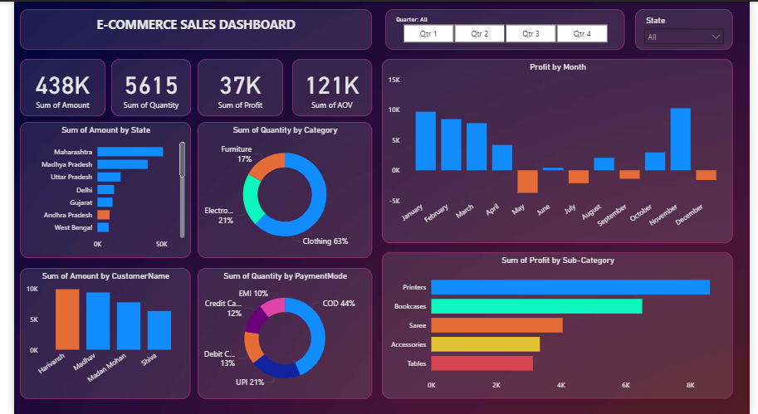
Result:
The Power BI dashboard provides the following insights:
• Total Sales Amount
• Total Quantity Sold
• Total Profit
• Average Order Value
• Sales by State
• Profit by Month
• Sales by Category
• Payment Mode Distribution
These visualizations help stakeholders easily understand business performance.

Slide 8
Conclusion:
The E-Commerce Sales Dashboard successfully analyzes sales data and presents it through interactive visualizations. The dashboard helps businesses identify top-performing states, profitable products, and customer purchasing patterns. Using Power BI enables faster decision-making and improves business strategy planning.

Slide 9
Future scope:
• Integrate real-time e-commerce data sources
• Apply machine learning models for sales prediction
• Add customer segmentation analysis
• Deploy dashboard on Power BI Service for online access
• Expand analysis with more advanced KPIs and forecasting

Slide 10
References:
1. Microsoft Power BI Documentation
2. Data Analytics and Business Intelligence resources
3. Kaggle E-commerce datasets
4. Power BI Learning Tutorials
GitHub Link:

Slide 11
Thank You

